Slide 1


Session 1
Eng-Adham Khaled

Slide 2

ICDL
What is ICDL?
International Computer Driving License, formerly known as European Computer Driving License (ECDL).

Slide 3
Content
Besics of computer and internet.
Microsoft office:
1) Microsoft word
2) Microsoft power point
3) Microsoft excel

Slide 4

computer
Computer Consists Of :
1)Hardware
2)software

Slide 5
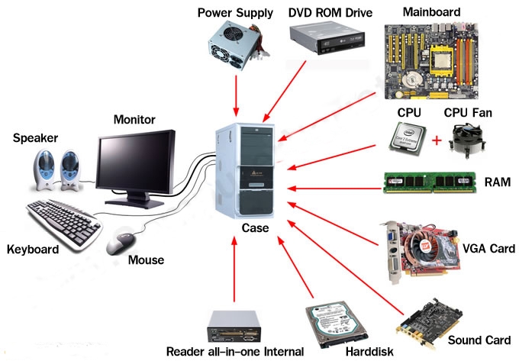
Hardware

Slide 6
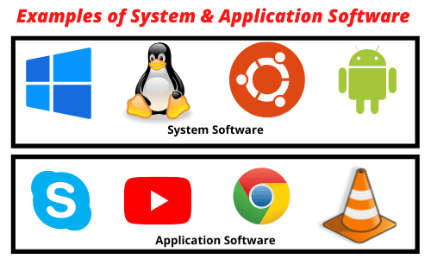
software

Slide 7
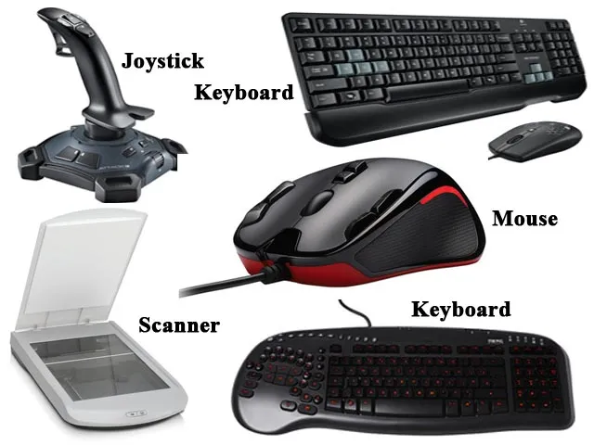
Hardware ( Input Devices)

Slide 8
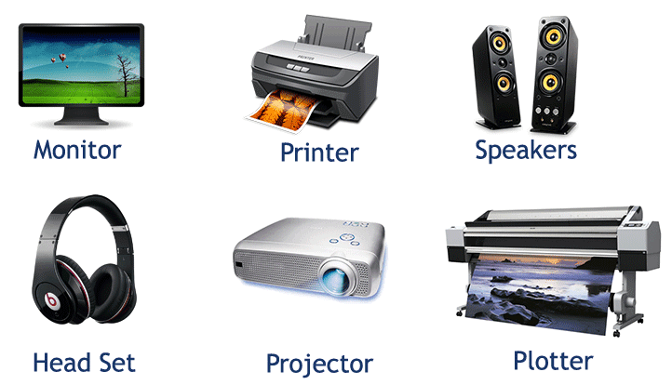
Hardware (Output Devices)

Slide 9
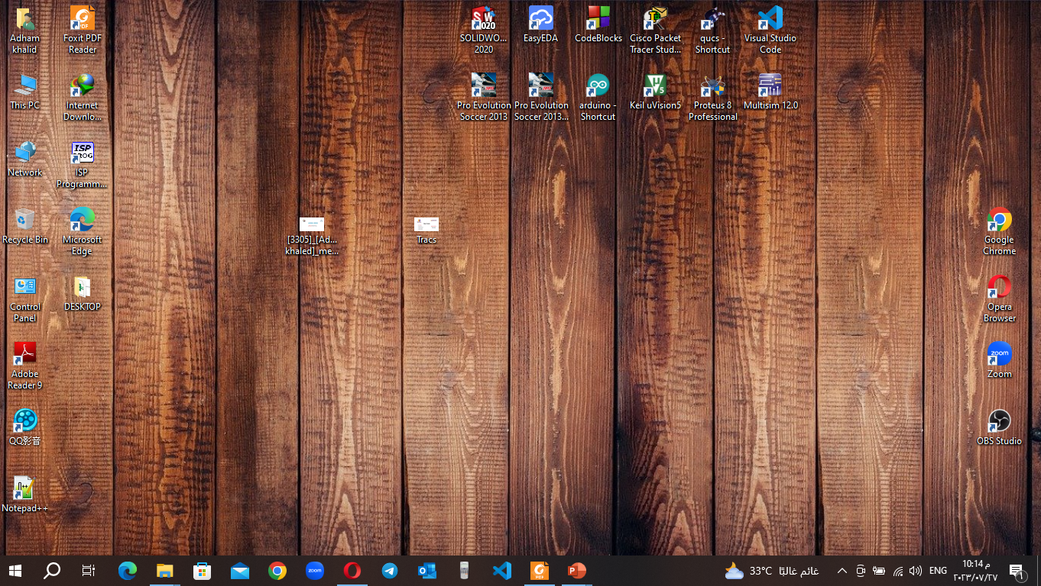
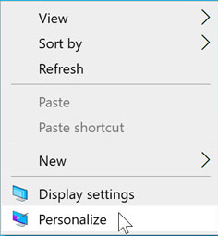
Desktop

Slide 10
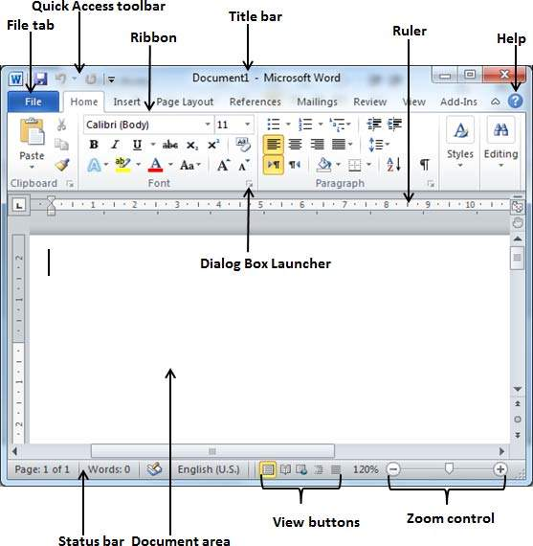
word

Slide 11


